Slide 1

the brave GNU world
Notes:
Note Page by Willem van der Plaat

Slide 2
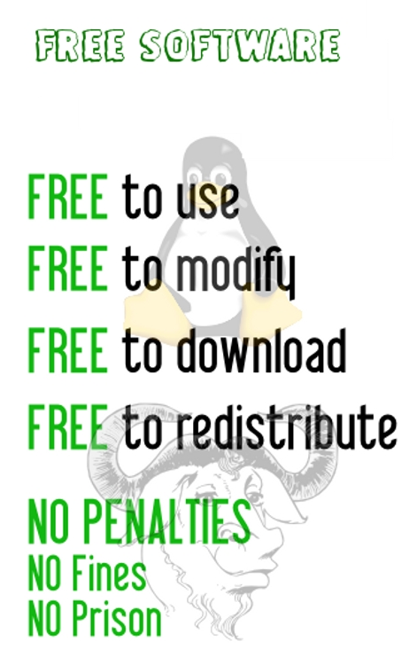
Free Software

Slide 3















Applications

Slide 4
Free Software Definition
Free software is a matter of the users' freedom to run, copy, distribute, study, change and improve the software. More precisely, it means that the program's users have the four essential freedoms:
The freedom to run the program, for any purpose (freedom 0).
The freedom to study how the program works, and change it to make it do what you wish (freedom 1). Access to the source code is a precondition for this.
The freedom to redistribute copies so you can help your neighbor (freedom 2).
The freedom to distribute copies of your modified versions to others (freedom 3). By doing this you can give the whole community a chance to benefit from your changes. Access to the source code is a precondition for this.

Slide 5






Who are using it?
Governments : NRCFOSS, FOSSEE, Universities, Keltorn – IGSG http://www.osor.eu/ etc. etc.
Schools : IT@School Project in Kerala
Companies: Intel, Google, Nokia, Sun/Oracle Facebook, Yahoo, IBM, Flipkart etc..
They are not just using Free Software but contributing too...

Slide 6
Why
Why should a CS student learn Free Software?

Slide 7
An interview with Bill Gates
Interviewer:
"Is studying computer science the best way to prepare to be a programmer?"
Bill Gates:
"No, the best way to prepare is to write programs, and to study great programs that other people have written. In my case, I went to the garbage cans at the Computer Science Center and I fished out listings of their operating system."
http://programmersatwork.wordpress.com/bill-gates-1986/
"Programmers at Work" by Microsoft Press

Slide 8
Programming Languages
Introduction to Programming
  Python - http://python.org
Data Structures
  C, C++ - GCC
Algorithm
  Python
Computer Graphics
  Python – pygame
Network Programming
  C, C++
Compiler Design
  Lex, Yacc, C
GUI Programming
  Python – pygtk

Slide 9
Programming Languages...
Assembly Language
  Nasm
Operating System
  C
Web Programming
  HTML, CSS, Java Script, PHP

Slide 10
Database
MySQL
PostgresSQL

Slide 11
A campus network
Single Sign-on
Moodle for Course management
Wordpress multi blogging platform
KOHA based online library management
Dspace/greenstone digital library to archive project reports/seminar papers etc.

Slide 12
Resources
http://fsf.org
http://gnu.org
http://debian.org
http://ubuntu.com
http://ubuntuguide.org
http://openoffice.org
http://python.org
http://php.net

Slide 13
Thanks...
questions??
vimal@space-kerala.org
http://c11.space-kerala.org/~vimal

